Slide 1
The F430
Ferrari Owner’s Club Kuala Lumpur

Slide 2
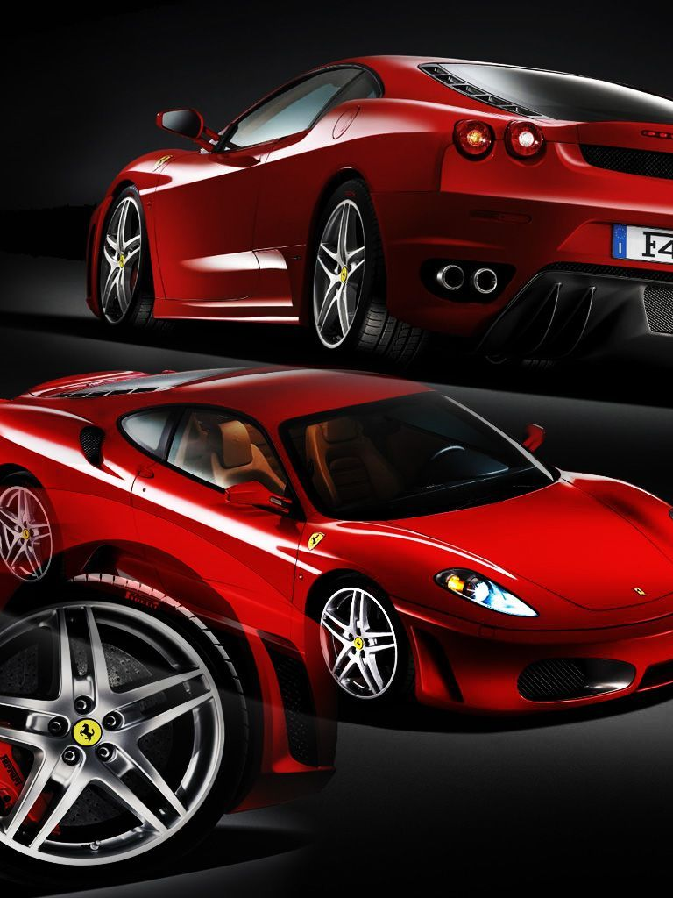

Slide 3
Ferrari F430
FROM PININFARINA & FRANK STEPHENSON
Designed by Pininfarina in collaboration with Frank Stephenson (Director of Ferrari-Maserati Concept Design and Development), the body styling of the F430 was revised from its predecessor, the 360, to improve its aerodynamic efficiency. Although the drag coefficient remained the same, the downforce was greatly enhanced. Despite sharing the same basic Alcoa Aluminium chassis, roofline, doors, and glass, the car looked significantly different from the 360. A great extent of Ferrari heritage was included in the exterior design. At the rear, the Enzo's tail lights and engine cover vents were added. The car's name was etched on the Testarossa-styled driver's side mirror. The large oval openings in the front bumper are reminiscent of Ferrari racing models from the 60s, specifically the 156 "shark nose" Formula One car.
The F430 features a 4,308 cc (4.3 L) V8 engine of the "Ferrari-Maserati" F136 family. This new power plant was a significant change for Ferrari, as all previous Ferrari V8's were descendants of the Dino racing program of the 1950s. This fifty-year development cycle came to an end with the entirely new engine used in the F430, the architecture of which replaced the Dino-derived V12 in most other Ferrari cars. The engine's output specifications are: 490 PS (360 kW; 483 hp), at 8,500 rpm and 465 N⋅m (343 lb⋅ft) of torque at 5,250 rpm, 80% of which is available below 3,500 rpm. Despite a 20% increase in displacement, engine weight grew by only 4 kg (8.8 lb) along with a decrease in diameter for easier packaging. The connecting rods, pistons and crankshaft were all entirely new, while the 4-valve cylinder head, valves and intake trumpets were directly retained from Formula 1 engines, for ideal volumetric efficiency. The F430 has a top speed in excess of 315 km/h (196 mph) and can accelerate from 0 to 97 km/h (60 mph) in 3.6 seconds, 0.6 seconds quicker than the old model.
The brakes on the F430 were developed in close cooperation with Brembo and Bosch, resulting in a new cast-iron alloy for the discs. The new alloy includes molybdenum which has a better heat dissipation performance. The F430 was also available with the optional Carbon fibre-reinforced Silicon Carbide (C/SiC) ceramic composite brake package. Ferrari claimed the carbon ceramic brakes will not fade even after 300-360 laps at their test track.
The F430 featured the E-Diff, a computer-controlled limited slip active differential which can vary the distribution of torque based on inputs such as steering angle and lateral acceleration.
Other notable features include the first application of Ferrari's manettino steering wheel-mounted control knob. Drivers can select from five different settings which modify the vehicle's ESC system, "Skyhook" electronic suspension, transmission behavior, throttle response, and E-Diff. The feature is similar to Land Rover's "Terrain Response" system.
The Ferrari F430 was available with exclusive Goodyear Eagle F1 GSD3 EMT tires, which have a V-shaped tread design, run-flat capability, and OneTRED technology. In the US, the company requested an exemption from the airbag design requirements, which was eventually granted, allowing the car to continue to be sold in the US.

Slide 4
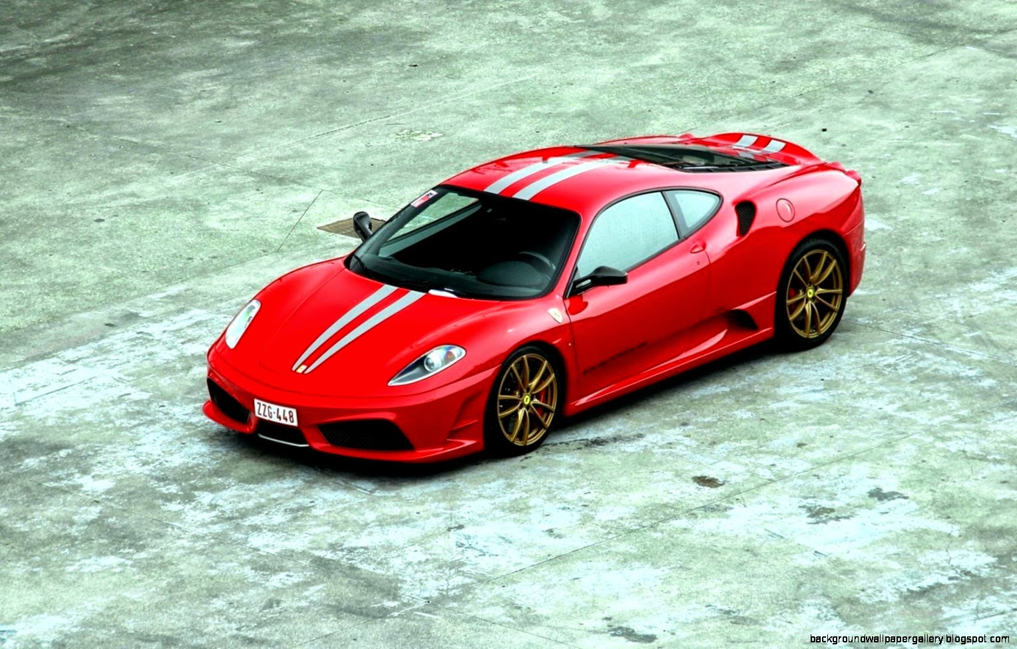
The Scuderia
SUCCESSOR OF 360 CHALLENGE STRADALE
Serving as the successor to the 360 Challenge Stradale, the 430 Scuderia (scuderia meaning "stable", but also used in the context of motor racing teams, including Ferrari's own) was unveiled by Michael Schumacher at the 2007 Frankfurt Auto Show. Aimed to compete with cars like the Porsche 911 GT3 RS and the Lamborghini Gallardo Superleggera (superleggera meaning super light weight), it is lighter (by 100 kg (220 lb)) and more powerful (510 PS (375 kW; 503 hp) at 8,500 rpm and 471 N⋅m (347 lb⋅ft) of torque at 5,250 rpm) than the standard F430.
Increased power comes from a revised intake, exhaust, and an ion-sensing knock-detection system that allows for a higher compression ratio in the engine. Thus the weight-to-power ratio is reduced from 2.96 kg/hp to 2.5 kg/hp. In addition to the weight saving measures, the Scuderia's single-clutch automated manual gained improved "Superfast" software, known as "Superfast2", for faster 60 millisecond shift times. A new traction control system combined the F1-Trac traction from the 599 GTB and stability control with the E-Diff electronic differential. The Ferrari 430 Scuderia accelerates from 0-100 km/h (62 mph) in 3.6 seconds, with a top speed of 319 km/h (198 mph).
Although the 430 Scuderia was not available with a manual transmission, a Texas-based tuning company converted a 430 Scuderia to a manual transmission using factory parts from Ferrari thus making it the only example in the world to have a manual transmission.

Slide 5
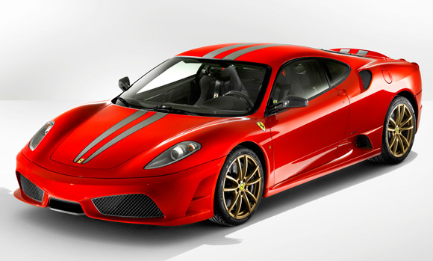
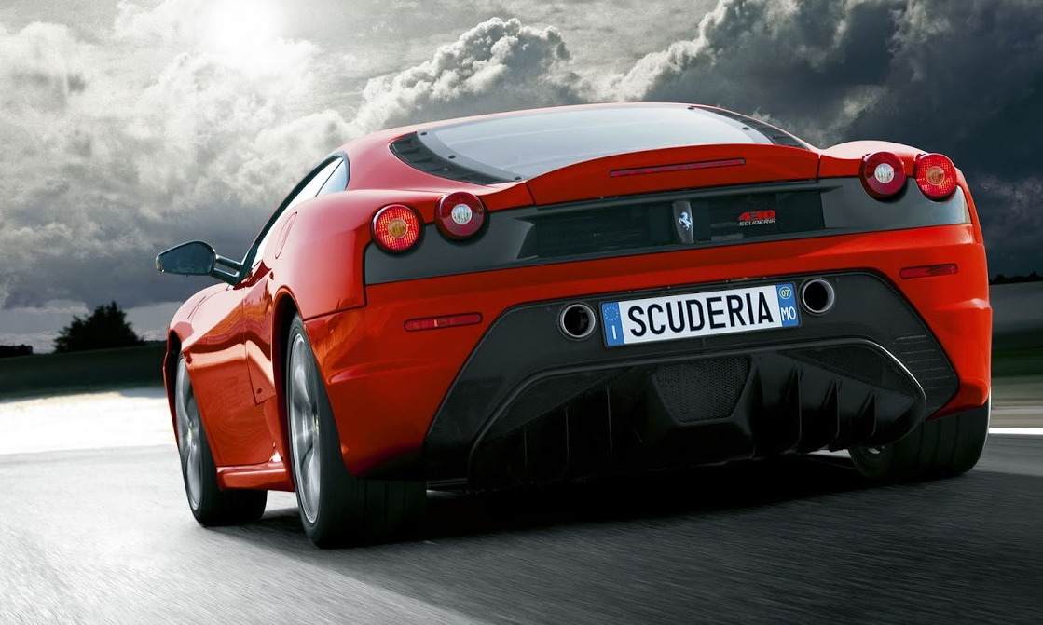
Ferrari produced only 2,000 F430 Scuderia
Ferrari's Formula 1 racing team is called Scuderia Ferrari, with Scuderia translating from Italian as “stable”

Slide 6
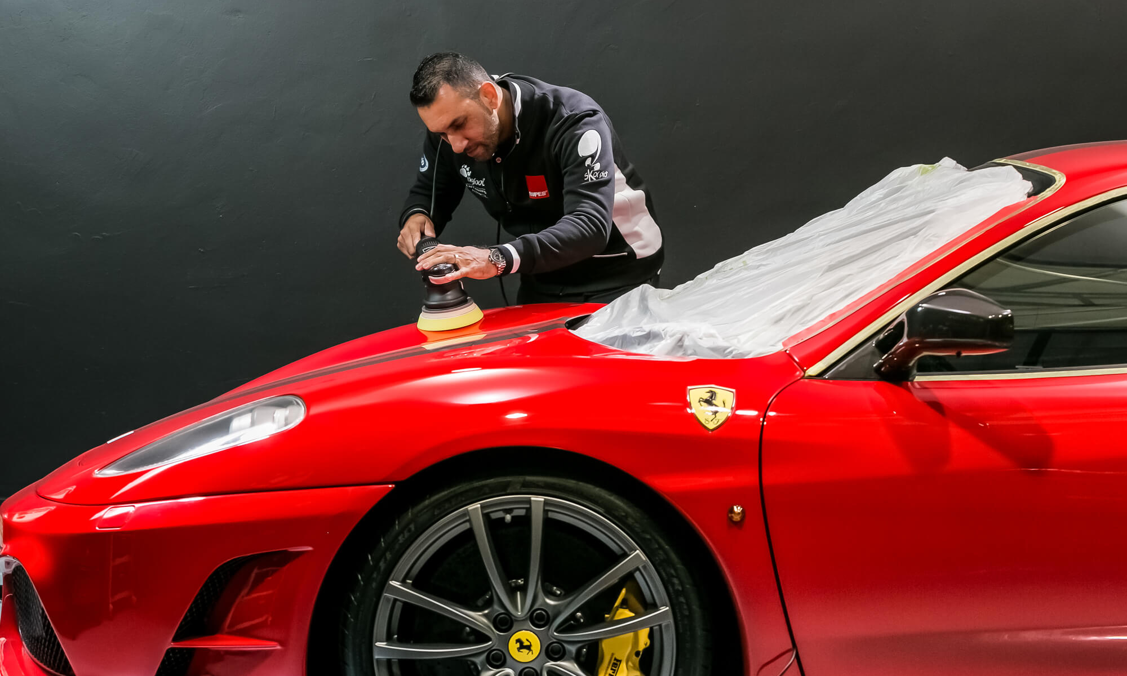
Racing Versions
F430 CHALLENGE AND GT3
The F430 Challenge is the track version of the F430, designed for the Ferrari Challenge. The engine remained untouched but the vehicle's weight was reduced, resulting in a top speed of 325 km/h (202 mph). The production model was unveiled at the Los Angeles Auto Show in January 2005.
Built since 2006 by Ferrari Corse Clienti department in collaboration with Michelotto Automobili, the F430 GTC is a racing car designed to compete in international GT2 class competition, such as in the American Le Mans Series, Le Mans Series, and FIA GT Championship. F430 GTCs also compete at the 24 Hours of Le Mans. The GTC was the fastest and most developed racing version of the F430.
In FIA GT2 championship, in order to render the car performances more uniform, the cars are forced to run with a specific minimum weight and with an engine restrictor that depends on the engine displacement. Hence Ferrari destroked the 4.3 L V8 engine to 4.0 L in order to compete in the 3.8–4.0 L class in GT2 class racing, which is allowed to race with a minimum weight of 1,100 kg (2,425 lb). In this race configuration, the engine produces somewhat less power (445 PS (327 kW; 439 hp)) and by using the 4.0 L engine, the minimum weight of the F430 would increase by 50 kg (110 lb) but this is compensated by the reduced weight of the car, which yields a better power-to-weight ratio.

Slide 7
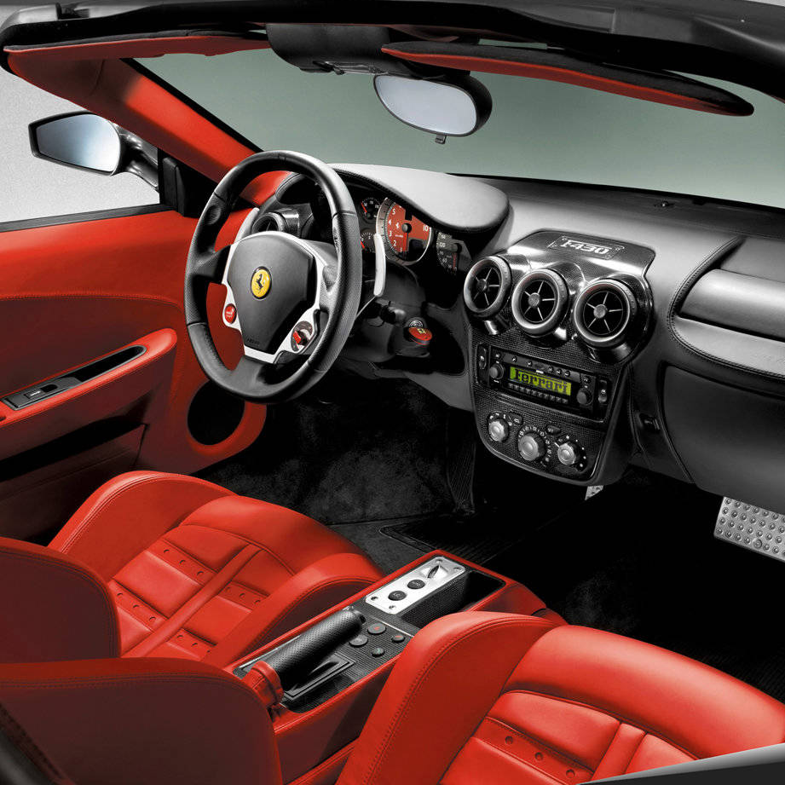
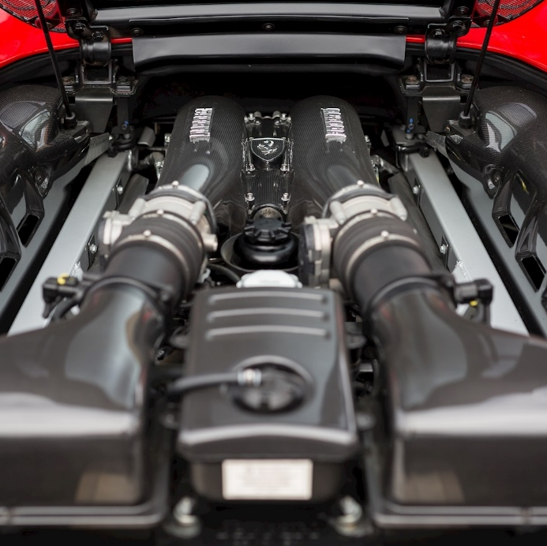
THIS CORPORATE PROFILE IS SPONSORED BY
Kuala Lumpur International Education Consortium
KLIEC.ORG

Slide 8
The F430 FERRARI OWNER’S CLUB KUALA LUMPUR

