Slide 1
System Developer:
Centre for Continuing Education and Professional Studies:
London Postgraduate Advancement Programme (LPAP)
ProMBA/MBA/PhD
Designed by:
Kuala Lumpur International Education Consortium Berhad
Last update:
22 DEC 2022

Slide 2
LPAP Partners

Slide 3
LPAP Active List
Elite–UUM PhD Doctor of Philosophy (MQF)
London–Alfa PhD Doctor of Philosophy (MQF)
Gloucestershire MBA Master of Business Administration
UOG-LISA MBA Master of Business Administration
London–Alfa MBA Master of Business Administration (MQF)
London–Saito MBA Master of Business Administration (MQF)
UTMSPACE ProMBA Professional Master of Business Administration
London Exam Board PCIS Professional Certificate in Innovation and Strategy

Slide 4
With or without
Bachelor’s Degree
MBA UK (RQF)
ProMBA + PCIS (IEMX)
PhD MY (MQF)
Elite-UUM
London-Alfa
PhD
MBA MY (MQF)
London-Alfa
London-Saito
MBA
With Bachelor’s Degree

Slide 5
Programme Details
 | UTMSPACE ProMBA | London-Saito MBA | London-Alfa MBA | CEO MBA UK Gloucestershire | UOG-LISA MBA
Duration | 1 Year | 1½ Years | 1½ Years | 1½ Years | 1½ Years
Entry | 8 years working experience | Bachelor’s Degree | Bachelor’s Degree | 8 years working experience | 10 years business experience
Certification | 2 | 3 | 3 | 5 | 6 + 1
Modules | 10 | 11 | 13 | 12 | 12
Assignments | 7 | 8 | 10 | 9 | 9
Thesis / Project | 1 | 1 | 1 | 1 | 2

Slide 6
Academic Structure
 | UTMSPACE ProMBA (1 Year) | London-Saito MBA (1½ Years) | London-Alfa MBA (1½ Years)
STAGE 1 (8 months) | Project Management Human Resource Management Business Ethics Economics Corporate Finance ​Organizational Behavior ​​Entrepreneurship | Project Management & Consultancy Human Resource Management Economics for Managers Accounting & Finance for Managers Managing People & Organization E | Operation Management (Broc) Managerial Accounting and Business Finance 7053 Managing Talent & Leadership 7033 Business Law and Ethics 7083 Managerial Economics 7103 Entrepreneurship 7043
STAGE 2 (1 month) | Strategic Management Marketing Innovation | Strategic Management Marketing Management | Strategic Management 7023 Marketing and Communication 7063
STAGE 3 (4 months) |  | Business Analytics Data Intelligence | Business Analytics 7073 International Business 7114 Entrepreneurship Lab 7124
STAGE 4 (3 to 5 months) | Business Research Master Projects | Research Methodology Capstone Project | Research Methodology 7093 Business Project 7146

Slide 7
Academic Structure
 | UTMSPACE ProMBA (1 Year) | CEO MBA UK Gloucestershire (1½ Years) | UOG-LISA MBA (1½ Years)
STAGE 1 (8 months) | Project Management Human Resource Management Business Ethics Economics Corporate Finance ​Organizational Behavior ​​Entrepreneurship | Project Management PM Human Resource Management MHC Economics MA Corporate Finance FM | Project Management PM Human Resource Management MHC Economics MA Corporate Finance FM
STAGE 2 (1 month) | Strategic Management Marketing Innovation | Strategic Management PM Marketing Innovation MM | Strategic Management PM Marketing Innovation MM
STAGE 3 (4 months) |  | Leading Organisation LO Managing Business Strategy MBS | Leading Organisation LO Managing Business Strategy MBS
STAGE 4 (3 to 5 months) | Business Research Master Projects | Business Research Thesis | Business Research Thesis + L4 Project

Slide 8
Fee Structure
 | UTMSPACE ProMBA | London-Saito MBA | London-Alfa MBA | CEO MBA UK Gloucestershire | UOG-LISA MBA
Registration (Month 0) | RM 19,821 | RM 19,821 | RM 19,821 | RM 19,821 | RM 24,821
Month 6 | RM 10,000 | RM 10,000 | RM 10,000 | RM 10,000 | RM 15,000
Month 12 |  | £ 1,800 | £ 2,800 | £ 2,800 | £ 2,800
TOTAL | RM 29,821 | RM 29,821 + £ 1,800 | RM 29,821 + £ 2,800 | RM 29,821 + £ 2,800 | RM 39,821 + £ 2,800
Estimated Average Fee | RM 2,485 / mth | RM 2,207 / mth | RM 2,512 / mth | RM 2,512 / mth | RM 3,068 / mth

Slide 9
Luxury MBAs in Malaysia
Programme | Certification | Tuition Fee | Duration | Location
Monash MBA | 1 | RM 66,000 | 1½ Years | Bandar Sunway
Nottingham MBA | 1 | RM 60,500 | 2 to 4 Years | Semenyih
Heriott-Watt MBA | 1 | RM 56,250 | 2 Years | Putrajaya
Taylor’s MBA | 1 | RM 49,689 | 1½ to 2 Years | Subang Jaya
CEO MBA UK Gloucestershire | 5 | RM 45,221 | 1½ Years | KL & London
London-Saito MBA | 3 | RM 39,721 | 1½ Years | KL & London
Last Updated: 2019

Slide 10
PCIS 2023
Date | Event | Venue
2 Oct 2023 | PCIS Seminar | University of London
3 Oct 2023 | PCIS Seminar | University of London
4 Oct 2023 | Industrial Visit | Land-Rover Birmingham
5 Oct 2023 | Corporate Presentation Skills | University of London
6 Oct 2023 | Group Presentation | University of London
7 Oct 2023 | LISA Award Presentation | UK Parliament, London

Slide 11
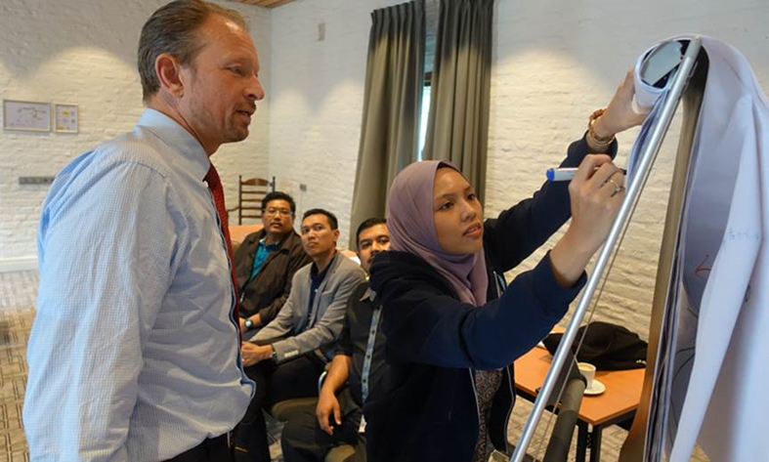
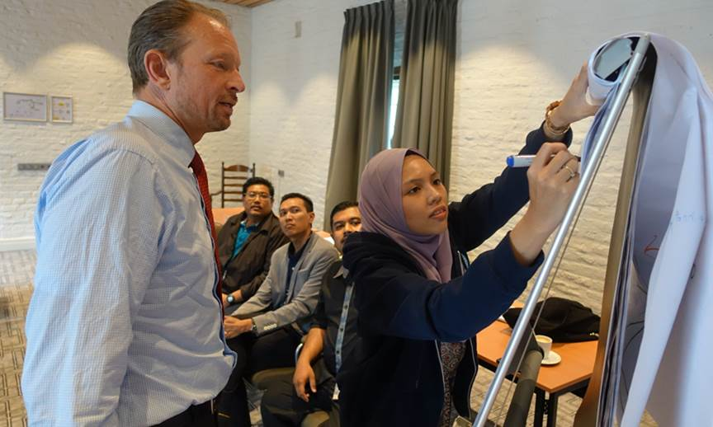
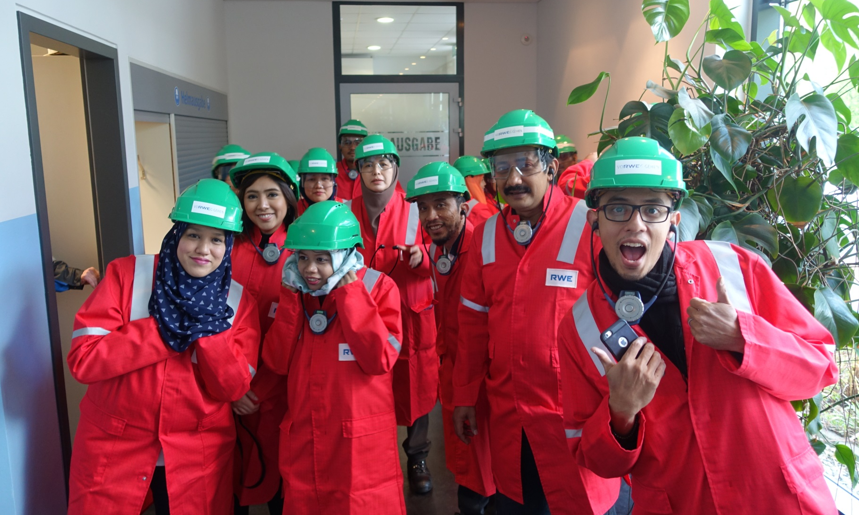
PCIS 2017/18

Slide 12
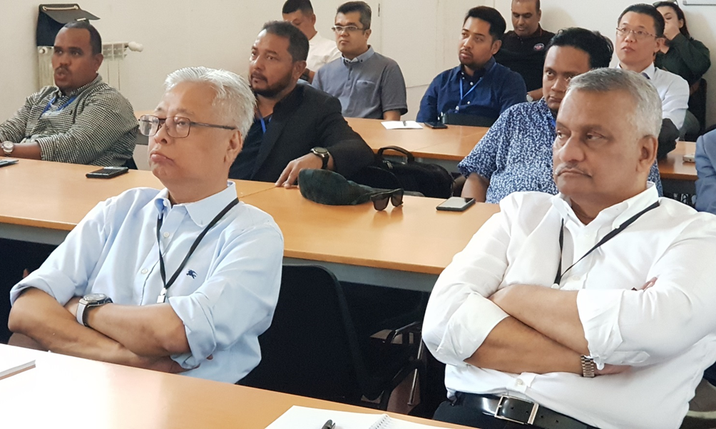
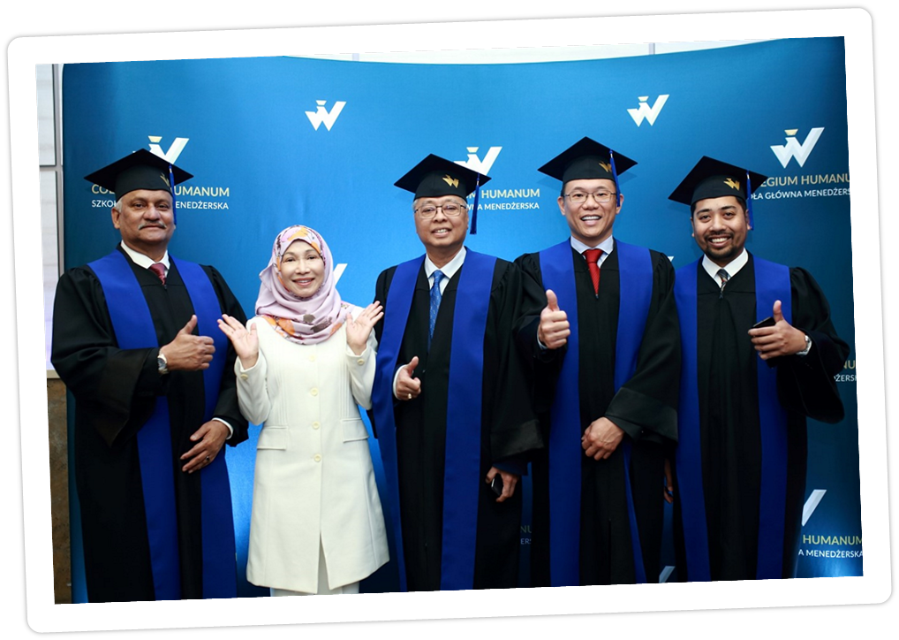
PCIS 2018/19

Slide 13
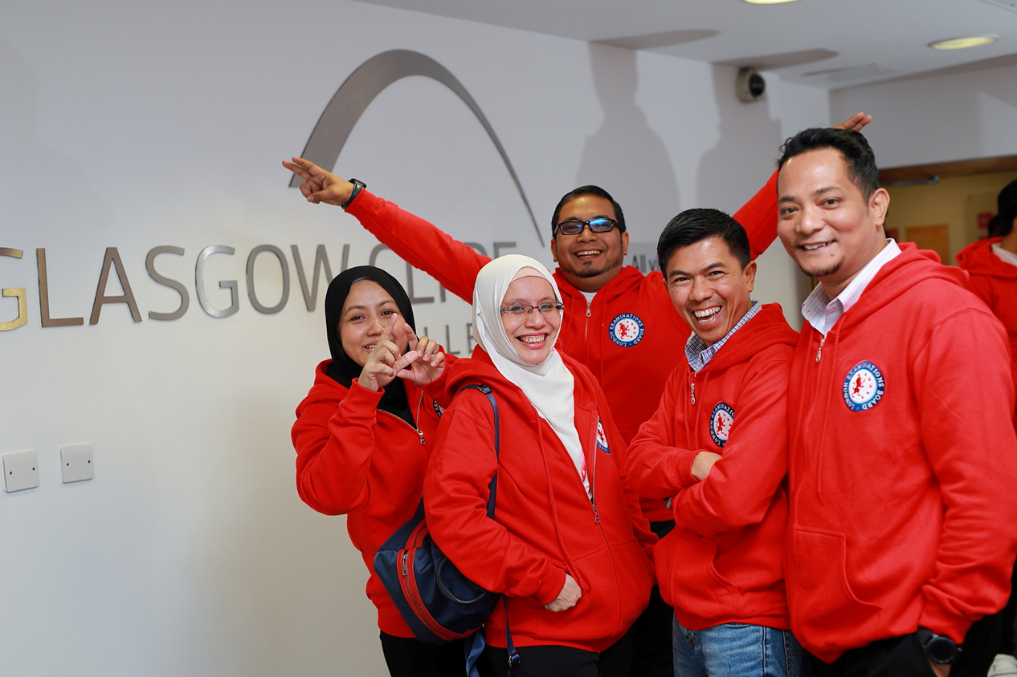
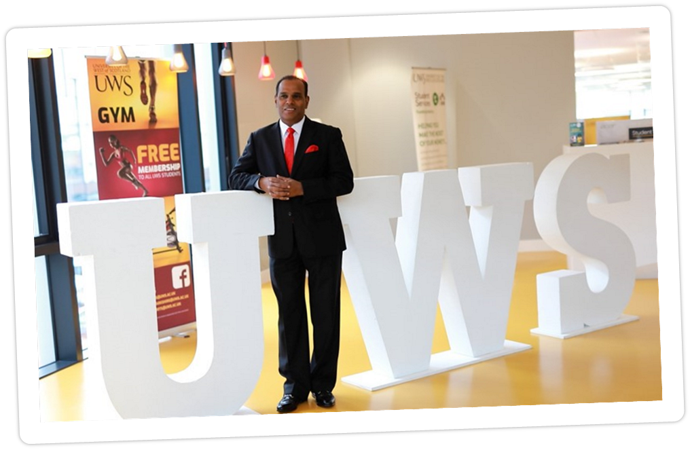
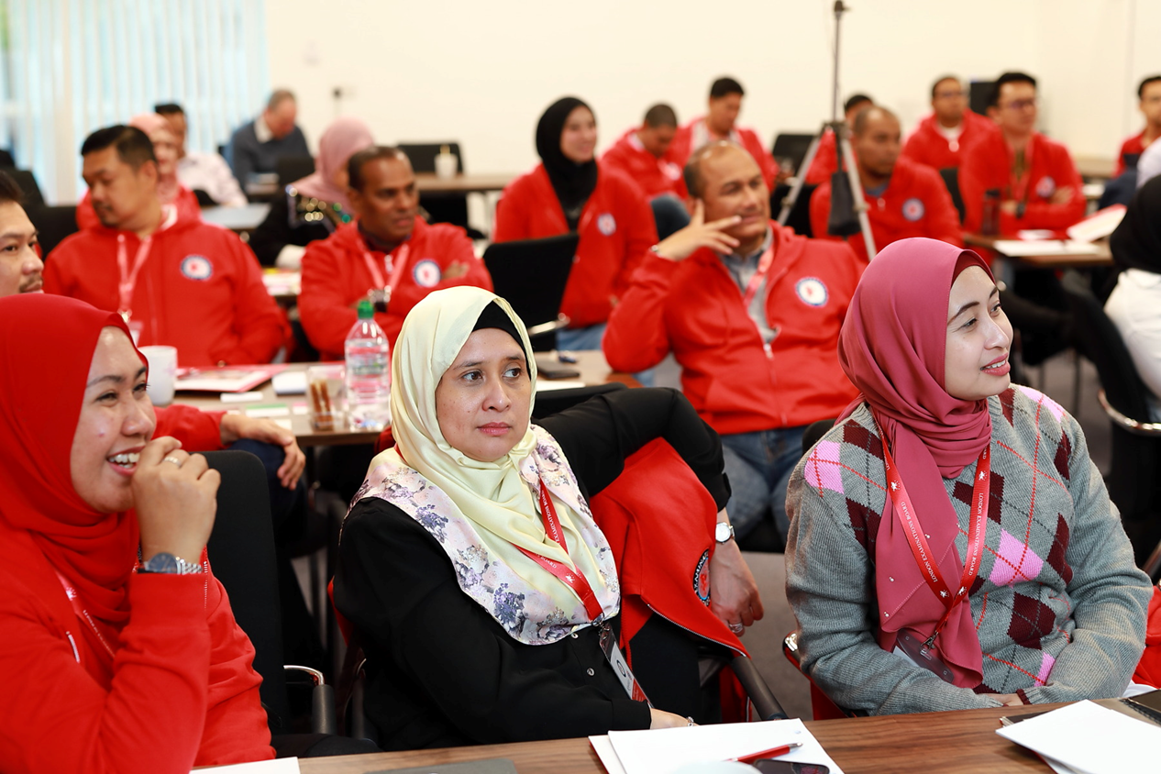
PCIS 2019/20

Slide 14
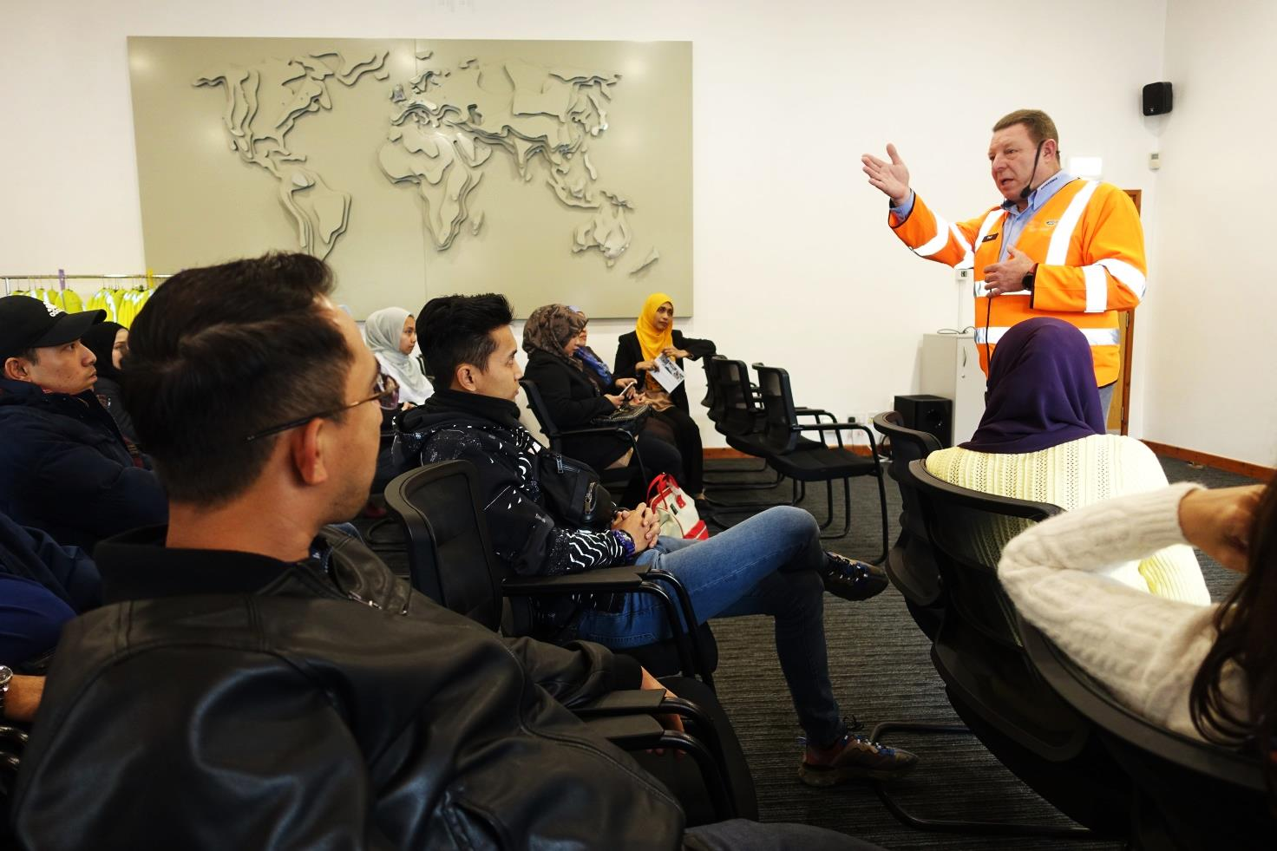
PCIS 2020/21

Slide 15
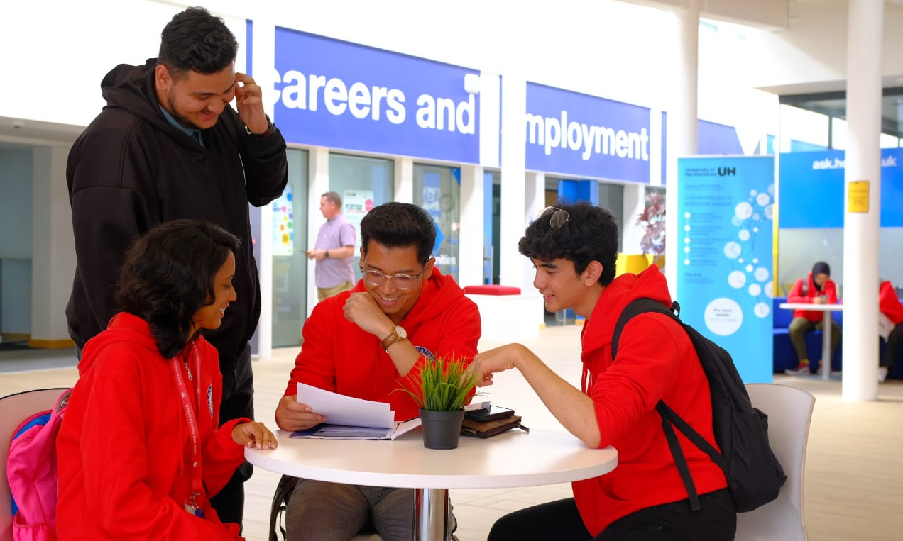
PCIS Jr 2021/22

Slide 16
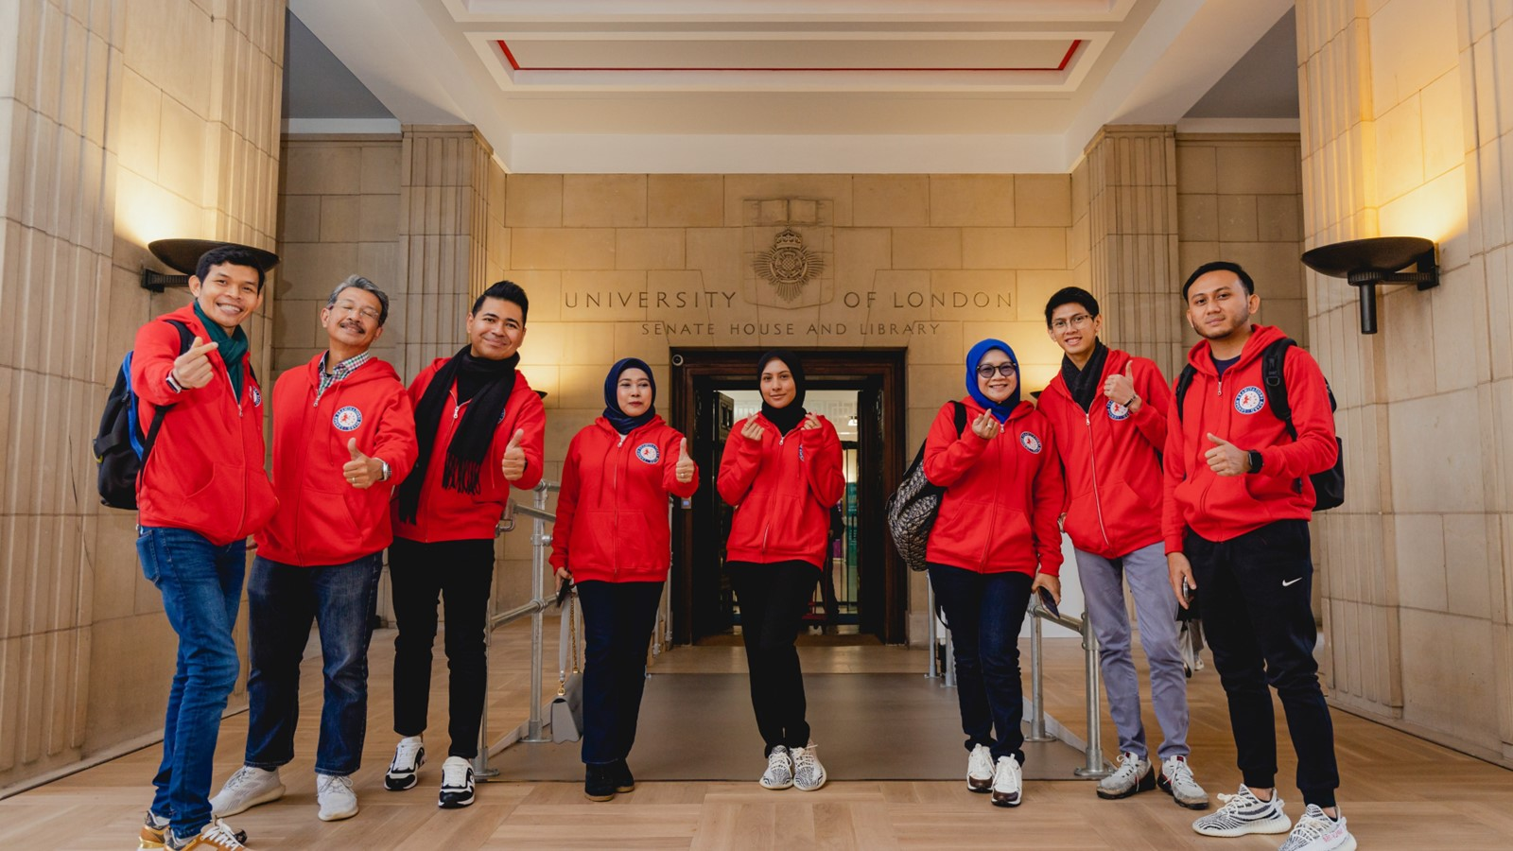
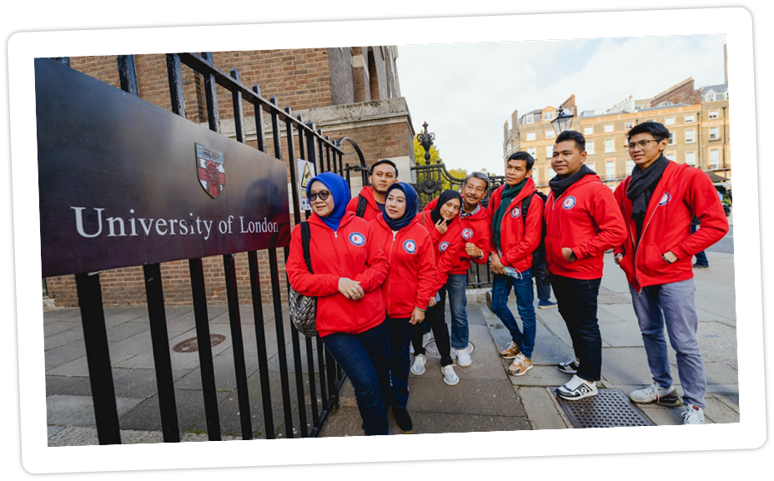
PCIS 2022/23

Slide 17
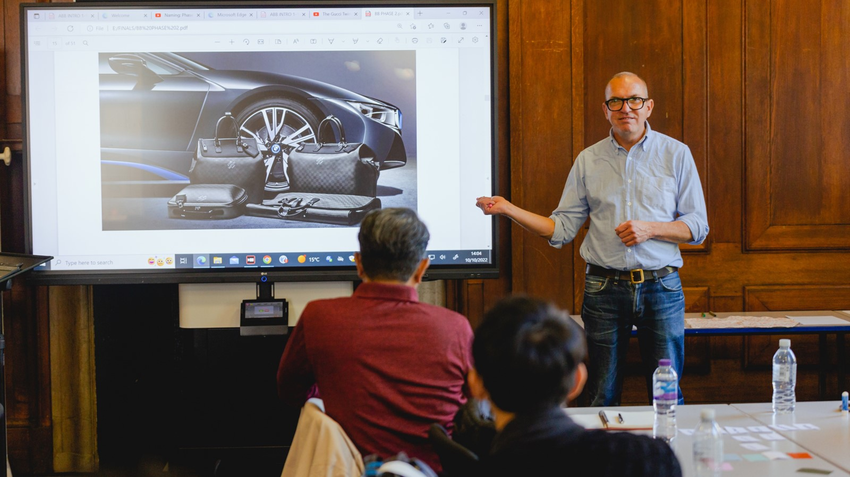
PCIS 2022/23

Slide 18
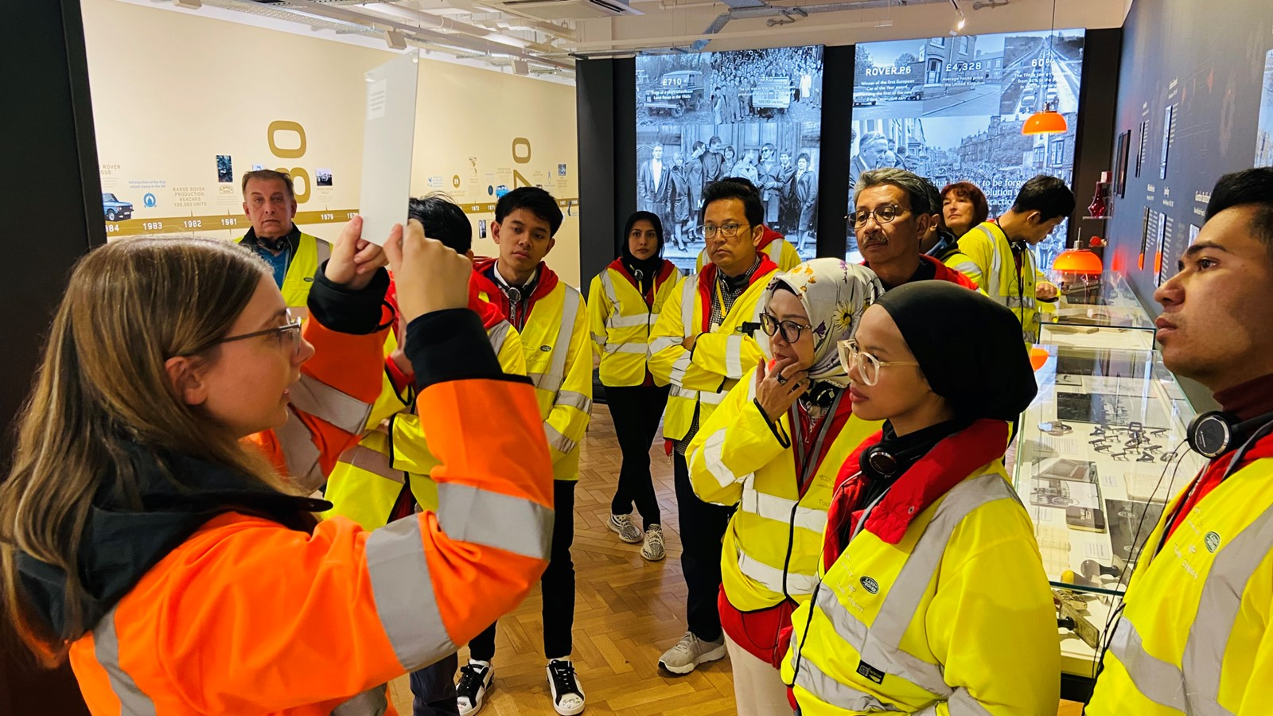
PCIS 2022/23

Slide 19
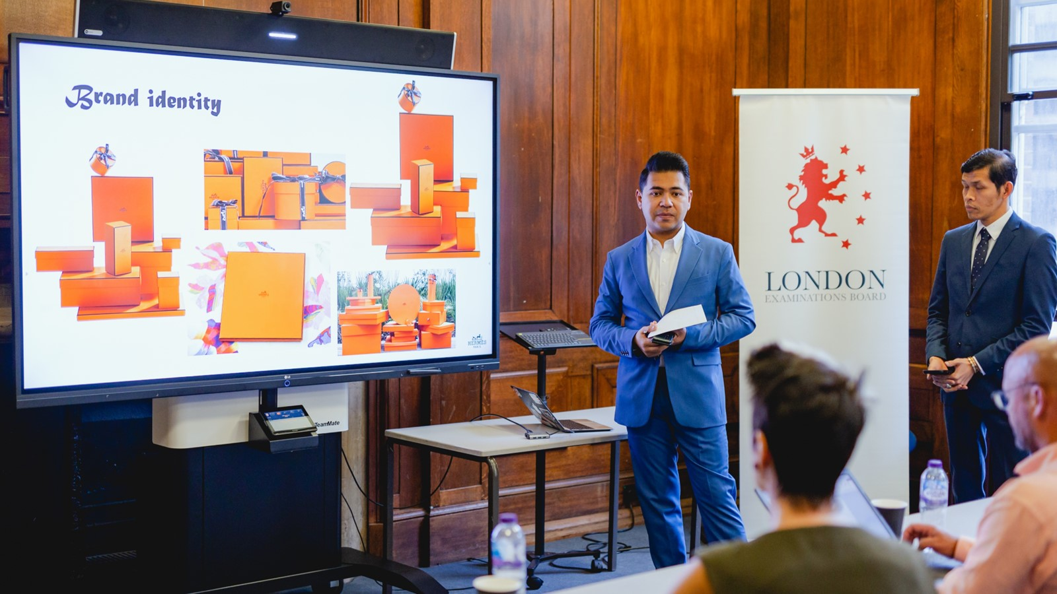
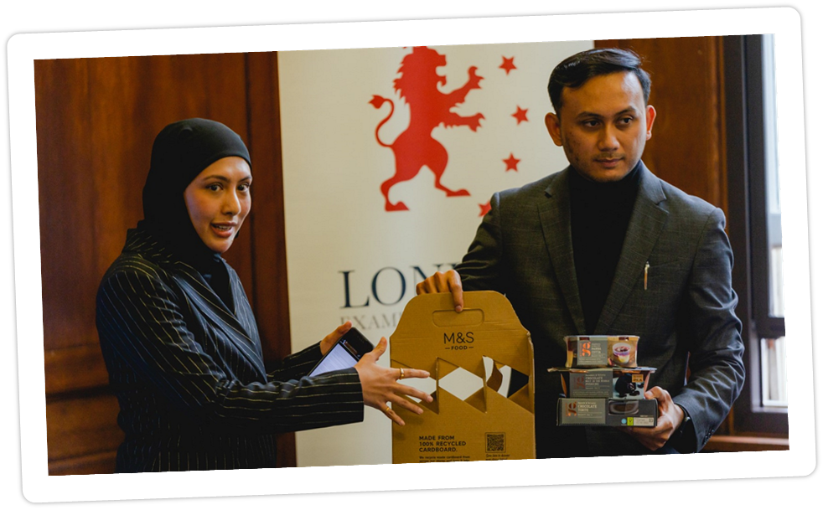
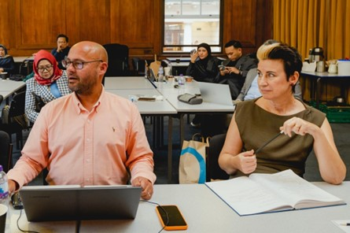
PCIS 2022/23

Slide 20
PCIS 2022/23

Slide 21
Land-Rover
United Kingdom
BMW
Germany
Ferrari
Italy
European Parliament
Belgium
Lamborghini
Italy
Seat
Spain
Maserati
Italy
Canon
Germany
Bayer
Germany
Aixtron
Germany

